Slide 1
Loose Coupling & Isolation
IoC and DIP

Slide 2

Isolation Is Key

Slide 3
Isolation Allows Us To …
Test concerns separately
Avoid fragile tests
Avoid context sensitivity
Keep tests repeatable
Have a better design

Slide 4
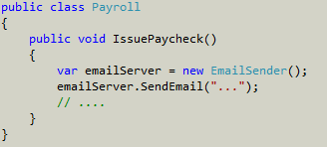
Decoupling Allows Us To
Be more flexible
Maintainable
Testable
Agile
Set at compile time

Slide 5

Dependency Inversion Principle
High level modules shouldn’t depend on low level modules

Slide 6
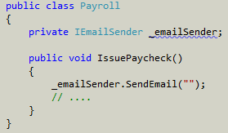

Inversion of Control
Control dependency creation
Control the executable flow

Slide 7
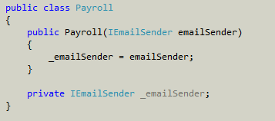
Dependency Injection
Achieves dependency inversion
Can also use service locator, factories, virtual methods

Slide 8

Inversion of Control Container
Enables inversion of control through dependency injection
StructureMap
Ninject
Unity
MEF (to an extent)

Slide 9
Dependency Injection
Pros
Loosely coupled components
Testability
Unobtrusive
Cons
Harder to see at compile time what components are in play

Slide 10

Test Doubles
Like stunt doubles, they substitute for “the real thing”

Slide 11

Stubs and Fakes
Stub will do the least amount of work possible
A fake will provide a complete implementation of something you can’t use in production

Slide 12
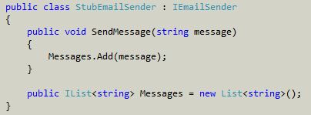
Spies
Make it easy to inspect side-effects and component interactions

Slide 13

Mocks
Sophisticated and dynamic
Can be a fake, stub, or spy
Generally created using a framework

Slide 14
Summary
A loosely coupled design is a testable design
A testable design is a good design

